Slide 1
Triggers: Born Evil or Misunderstood?
Louis Davidson

Slide 2
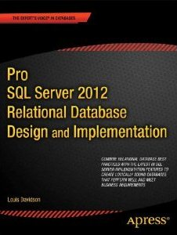
Who am I?
Been in IT for over 18 years
Microsoft MVP For 9 Years
Corporate Data Architect
Written five books on database design
Ok, so they were all versions of the same book. They at least had slightly different titles each time

Slide 3
Brief Introduction
Triggers are coded modules that are very similar to stored procedures
Not called directly, but are “triggered” by certain events
With “special” tools to access event data
Triggers existed in Microsoft SQL Server 1.0 (far before check constraints!)
Types:
DML –Table/View level, fire on INSERT, UPDATE and/or DELETE to a single object
Once per statement, regardless of number of rows
DDL – Server or Database level, fire whenever a DDL statement is executed
Login – Fire whenever a user logs into the server

Slide 4
Introduction - Continued
Triggers execute as part of the operation statement
ROLLBACK in the trigger will stop the operation (and anything else that is part of the current transaction)
Can use EXECUTE AS to elevate the permissions of the trigger code (in extreme circumstances!)
Never return any results from triggers
Ability to do so will be removed in an upcoming SQL Server version
Currently controlled with “disallow results from triggers” server setting
Should operate silently

Slide 5
The Setup…
In the following session we will put triggers on trial
I will play the part of Judge, Prosecutor, and Defense Attorney
I will provide many exhibits (aka Code Demos) to demonstrate my points
You will play the part of Jury Member and possibly Witness

Slide 6
Your Part of the Process - Jury
Judge triggers… You will be given the following choices, majority rules
You can find them
5 - Evil
4
3
2
1 – Misunderstood (aka Awesome!)
Then we discuss sentencing…

Slide 7
Come to order

Slide 8
Opening Statements - Prosecution

Slide 9
Triggers are dangerous
Sneaky…can do weird stuff to data that isn’t obvious
Performance could be affected
Difficult to get right unless you are really careful
Multi-row operations for DML triggers are commonly screwed up
Very often the source of problems that aren’t diagnosed because they execute silently
Error handling can be messy
Notes:
Sneaky
Conniving
Performance Zapping
Expect to insert 100 rows, but none entered
You check your WHERE clause, and it seems right…
Administrators should be able to tell, but typical end users will never know better

Slide 10
Opening Statement - Defense

Slide 11
What is the overall data problem?
Top Issue with Database Implementations
#1 Data Quality
#2 Does any other issue matter if the data quality is unsatisfactory?
Obviously performance and usability is important, but still quality is the most important thing
Anything we can do to manage our servers and keep the data clean the better
Triggers are a VERY small part of the picture!
But still a part of the picture…

Slide 12
Data Protection.1/3 – Start right!
Start by getting the structure correct
Normalization -Normalized structures are far less susceptible to data integrity issues
Datatypes
Match datatypes to the needs of the user
Data stored in the right datatype works better for the Query Processor
Make sure only the right people are modifying structures

Slide 13
Data Protection.2/3 - Constraints
NULL: Determines if a column will accept NULL for its value. NULL constraints aren’t technically constraint objects, they behave like them.
PRIMARY KEY and UNIQUE: Used to make sure your rows contain only unique combinations of values over a given set of key columns.
FOREIGN KEY: Used to make sure that any migrated keys have only valid values that match the key columns they reference.
DEFAULT: Used to set an acceptable default value for a column when the user doesn’t provide one. (Some people don’t count defaults as constraints, because they don’t constrain updates.)
CHECK: Used to limit the values that can be entered into a single column or an entire row.

Slide 14
Data Protection.3/3
Determine what can be reliably done using client code
Stored procedures
Compiled, procedural code
The key word in previous statement: “reliably”
Client code is notoriously untrustworthy
It gets worse when it a rule has to be enforced in multiple places
Often multiple layers implementing the same rules can be useful
Then come triggers…filling in gaps that can not be handled reliably in any other manner

Slide 15
Prosecution – Evidence

Slide 16
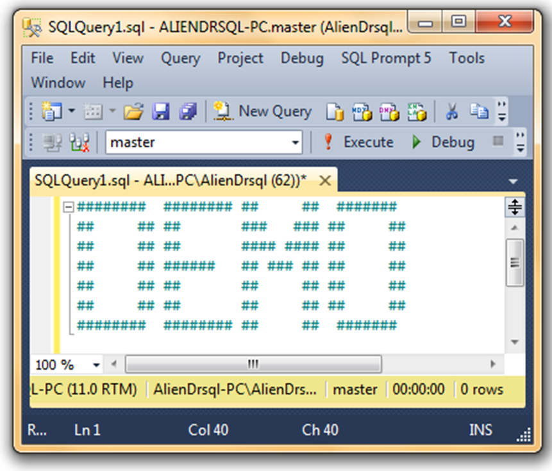
Exhibit A – Multi-row Operations
DML triggers must be coded using Multi-Row operations
Not getting this right can cause data to be allowed in that is actually incorrect

Slide 17
Exhibit B –Settings
Triggers are subject to settings at the server and the database level that can change how the code works AT RUNTIME!
Including:
sp_serveroption— nested triggers (default ON)– Determines if a DML statement from one trigger causes other DML triggers to be executed
Database option—RECURSIVE_TRIGGERS (default OFF)– Determines if an update on the table where the trigger fired causes the same triggers to fire again
sp_serveroption–disallow results from triggers (default OFF): Turn this setting on will ensure that any trigger that tries to return data to the client will get an error
sp_serveroption-server trigger recursion (default ON) – Determines if DDL in a server DDL trigger causes it to fire again

Slide 18
Exhibit C –Messy Error Handling
Errors that occur in triggers can result in multiple different outcomes, depending on how they are coded

Slide 19
Exhibit D –Weird Things Happen
DML Triggers can make the action you want to take not actually occur
This can go unnoticed for long periods of time, causing data loss
Even worse, sometimes triggers return results…by accident…

Slide 20
Prosecution – Last Minute Witnesses?

Slide 21
Defense – Evidence

Slide 22
Exhibit A –Skill and Templates…
It is true, triggers are not “simple”
However, the prosecution would have you believe they are impossible
With caution and process, they are very possible
Start from a template that sets you up for success

Slide 23
Exhibit B –Automatic Protection…
When coded properly, prevents data that does not meet minimum standards to be stored, even if the rules are complex..

Slide 24
Exhibit C – Makes Magic Happen
Triggers can, when needed do validations that other types of automatic code cannot:
Access data in multiple rows
Access data in a different table
Introduce side effects
Stop DML operations
Work on DDL operations
Work on Login operations

Slide 25
Exhibit C – Example Magic
Magical operations can occur with minimal coding where necessary and zero visible system impact
Examples
Clandestinely adding to third party systems
Row metadata (last modified time)
Logging changes to data

Slide 26
Exhibit D – Metadata Makes Life Easier
There are many bits of metadata in the catalog objects that make it easier to support triggers
sys.configurations: check the settings for nested triggers and results allowed
sys.databases: see if recursive triggers set to on
sys.triggers: list triggers and properties
sys.trigger_events: list events that cause triggers to fire
sys.dm_sql_referenced_entities: see objects and columns referenced in triggers

Slide 27
Exhibit E – Works on Any Edition
Express
Standard
Enterprise

Slide 28
Defense – Last Minute Witness?

Slide 29
Summation - Prosecution

Slide 30
Summation – Prosecution Points
Triggers are sneaky, devious objects
Triggers are the most complex code that has to be maintained
DBAs need to be cognizant of their existence of they will drive you NUTS
Any positives are always prefixed with: As long as you know what you are doing

Slide 31
Summation - Defense

Slide 32
Summation – Defense Points
Triggers fill a gap of data validation that cannot be done easily otherwise
Multi-row validations
Multi-table validations
Auditing (certainly where Version < Enterprise)
Complex Cascading operations
Triggers allow you to make silent changes to system (the prosecution called this sneaky, I call it useful)
As long as programmers/users are aware of their existence and purpose, they are helpful and useful tools

Slide 33
Ladies and Gentlemen of the Jury
It is time, what says you?
You can find them
5 - Evil
4
3
2
1 – Misunderstood (aka Awesome!)

Slide 34
Sentencing
Quit your job before being forced to use a trigger
Never use them in any case, unless your boss forces you to
Only use them when absolutely necessary and you can’t come up with any other method that would work
Use them in any case where they seem needed and you can’t think of any other solution
Use them for everything

